Slide 1
SHOP.COM | 美安台灣公司
美安獨家代理的優勢
營養保健產品
^{林曉凌 醫師}
© 2017 美安台灣公司版權所有 僅供內部教育訓練使用

Slide 2
為什麼建議你使用補充品？
優質的綜合維生素可以補充膳食的不足。
每個細胞都有維生素D受體，這就是表示維生素D在每個細胞的代謝中都扮演著重要的角色。
Notes:
My sayings go here
Emotional
Still this is not evidence
Gabe mate and his gut feeling

Slide 3
為什麼建議你使用補充品？
維生素B是必要「維生素」，代表人體無法自行製造。如無法製造，必須額外補充。
隨年紀增長，人體代謝減慢，消化效能和攝取飲食中的營養的能力下降，因此使用補充品不單是審慎的預防措施，而可能是重要的選擇。
Notes:
My sayings go here
Emotional
Still this is not evidence
Gabe mate and his gut feeling

Slide 4
解決方法：營養補充品
營養補充品提供每天所需的必要維生素及礦物質。
有些植物性營養素無法從食物中取得。
顯著改善健康（增強體力、增加關節的舒適度、皮膚健康、改善睡眠品質等）。

Slide 5
往幕後看，你會發現什麼？
研究營養補充品是否具有類似藥物效果的研究證實：
營養補充品不是藥！

Slide 6
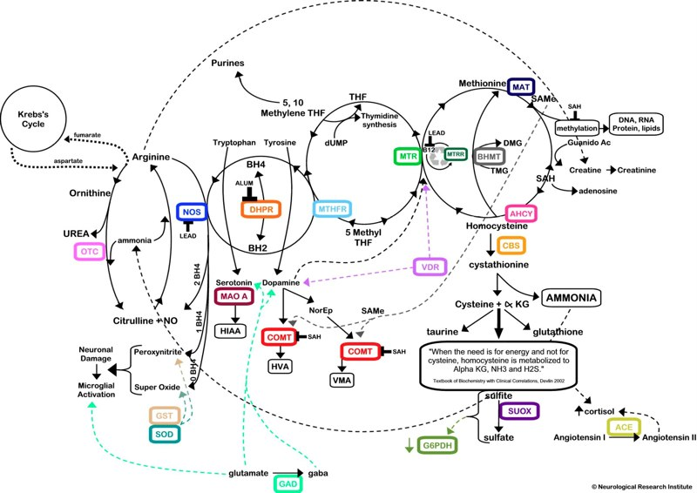
維生素B2、B3
鎂、維生素C、維生素B2
維生素C
維生素B6、B12、B9
維生素B6
Notes:
Detox

Slide 7
完整且具協同作用的配方
產品代理商 vs. 產品製造商
作為產品代理商，美安公司與多家供應商簽署了獨家協議，確保我們有多種類別的優質產品。
    不依賴銷售單一製造商的產品
    可因應市場需求
高標準的品質管理

Slide 8
經過臨床研究的先進成分
Pycnogenol®
Astareal®
Tonalin®
Bio-Tract™
Live Bac™
Wellmune®
Actice Aloe™
Reservine™
Fibersol®-2
DigeZyme™

Slide 9
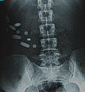

Slide 10
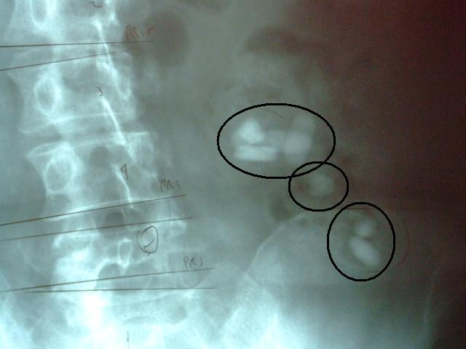

Slide 11
什麼是「等滲透」？
您身體體液的溶解鹽、醣類及礦物質的濃度幾乎是固定的。在此濃度下，細胞代謝所需的營養素和分子，能最有效地透過細胞膜輸送。
為了將腸道內的溶液傳輸至血液，溶液必須盡可能與體液相似。
這種傳輸的方式則稱為「等滲透」。

Slide 12
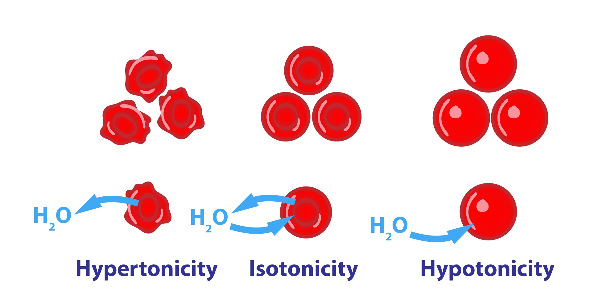
高滲透
等滲透
低滲透
Notes:
What does Isotonix® mean?
Isotonix® dietary supplements are delivered in an isotonic liquid solution. This means that the body has less work to do in obtaining maximum absorption. The isotonic state of the suspension allows nutrients to pass efficiently into the small intestine and be rapidly delivered into the bloodstream. With Isotonix® products, little nutritive value is lost, making the absorption of nutrients highly efficient while delivering maximum results.*

Slide 13
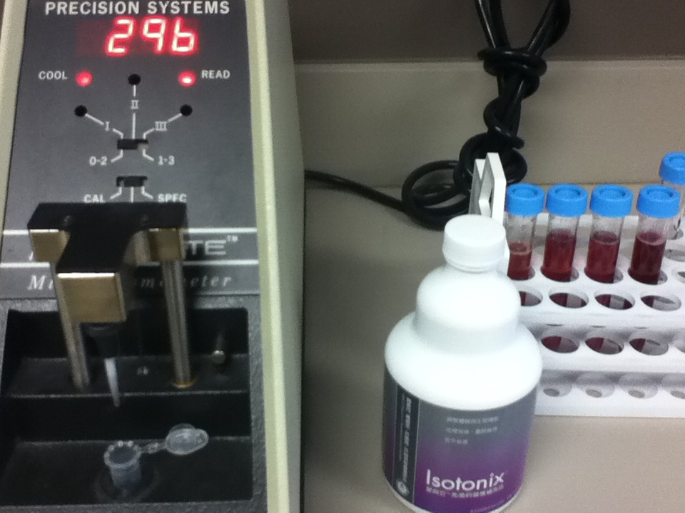
等滲透壓 = 270 - 310 mOsm/kg

Slide 14
多快才算得上快？
藥錠在離開胃時只有部分溶解
與基線比較，血漿中自由基減少率 [單位/分鐘]
OPC-3 等滲透配方
OPC-3 錠
服用後時間 [分鐘]
M.R. Cesarone, et al. Phytother. Res. 2009
Notes:
So how fast is “fast?”
Here is a study done with OPC-3 in Isotonix form and tablet form. The reduction in free radicals in the blood was monitored over time. The red bars, representing Isotonix OPC-3 took only 7-8 minutes after consumption to achieve maximum activity in the blood. While the same amount of OPC-3 in tablet form slowly built up concentration in the blood over a period of 1 hour. One reason for this is because the tablet, which was formulated to immediately release, was propelled into the intestine before it fully dissolved. This is because the water used to take the pill could not control gastric empyting like an Isotonix solution.

Slide 15
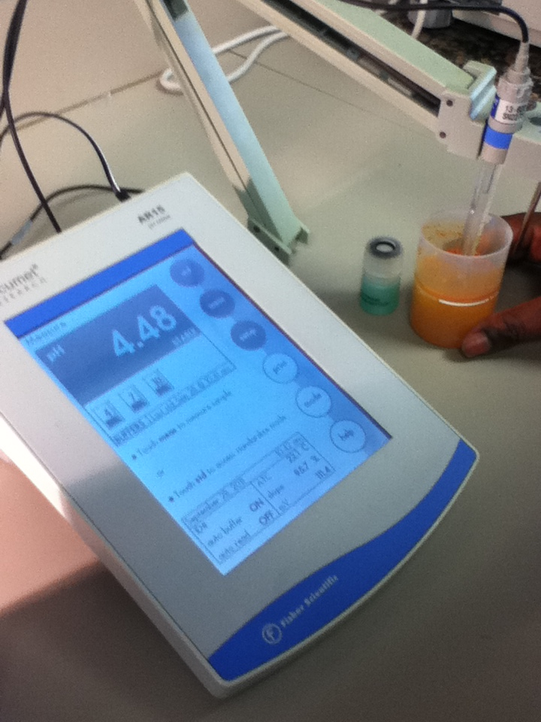
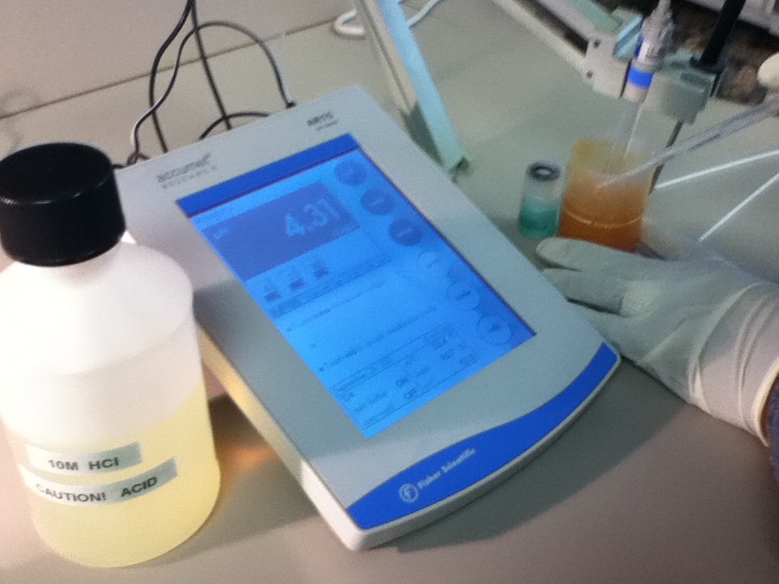
當愛尚它®綜合維生素遇到高濃度酸液

Slide 16
要提供「最好的」傳輸效果，方法不只一種...
為何不把所有的美安產品
都做成等滲透呢？

Slide 17
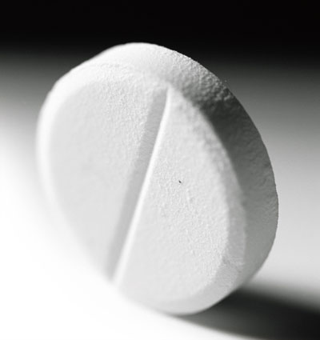
何時會使用膠囊錠狀形式？
有些成分不溶於水或無法散開。
有些成分具有獨特的味道或口感，無法被輕易掩蓋。
有些成分是油或油性。
以植物基底的成分會做成膠囊錠狀形式，因此才能通過正常的消化過程後釋放活性成分。
Notes:
Now let’s look at pills, which are the most common delivery system for dietary supplements and drugs.
You may be asking yourself, if Isotonix delivery is so great, why would you use pills? Well, there are some very good reasons.
Not every ingredient is compatible with water. Some ingredients do not dissolve or disperse in water.
Some ingredients have a bad odor or taste.
Some ingredients are oily, like fish oil. And of course oil and water do not mix.
Lastly, dried plant roots and leaves are commonly used in dietary supplements. These materials have not been extracted with a solvent, but instead, have been ground up into a fine powder. Natural plants materials need to be digested in order to release the actives they contain. And the best way to do this, is by pill delivery

Slide 18
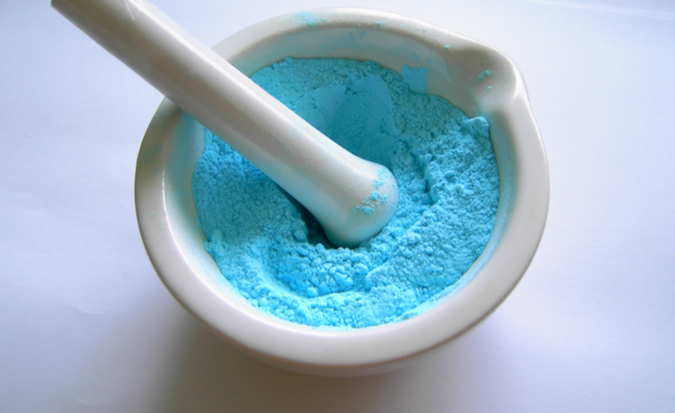
膠囊錠狀產品欲發揮最大作用，
必須謹慎選擇添加的「其他成分」
Notes:
Let’s talk about excipients, sometimes called “other ingredients.”
Excipients are substances other than the actives. Actives are listed in the nutrition information panel and excipients are listed below the nutrition information panel under “Other Ingredients.”
Excipients help to transport the actives to the body’s absorption site; they help the tablet to disintegrate into particles; and they some excipients are used simply to make the product taste and look better.

Slide 19
特殊科技
Soft gel Technology軟膠囊製造技術
LiveBac™片劑製造技術
Bio-Tract™輸送技術
Phytosomes™製劑技術

Slide 20
美安公司對你的承諾
確保產品在進入我們的設施之前滿足特定法規標準。
營養補充品將進行化學檢測，確保產品符合標籤上的宣稱，以及檢測微量和重金屬含量。

Slide 21
結 論
美安公司的產品不論是等滲透的粉末、軟膠囊或錠劑型態，全都使用最先進的科技與成分。
Notes:
So in conclusion, I hope you can see that there are many innovative ways to deliver nutrients and plant extracts to the body. Because supplement ingredients have such a broad range of chemical and physical properties, we have to be creative and thoughtful in selecting the most appropriate delivery system.
No matter which delivery system is used, the goal remains the same - to maximize absorption of the nutrients and make the customer satisfied so that they continue to take the product and realize a positive health benefit.

Slide 22

健康就是財富

